Slide 1


XAML
What is XAML, Features, MVVM
SoftUni Team
Technical Trainers
Software University
http://softuni.bg

Slide 2
Table of Contents
What is XAML?
What is XML?
XAML Features
Animations
Speech Recognition
Audio Video
MVVM Pattern

Slide 3

XAML

Slide 4
What is XAML?
Stands for eXtensible Application Markup Language
Declarative markup language for building UI
Based on XML
Used to simplify creation of UI for a .NET apps
Separates presentation (UI) from business logic
XAML enables a workflow where different parties can work simultaneously
The UI and the logic of an application can be developed using different tools (VS and Blend)

Slide 5
What is XAML?
XAML File/Code
XAML Processor
Code
Compiler
App Executable
C# Source

Slide 6
What is XAML? (2)
It is used for creating and initializing .NET objects
Used as a human-authorable way of describing the UI
Used to separate the UI from the business logic
XAML contains a hierarchy of elements representing visual objects
These objects are known as user interface elements or UI elements

Slide 7
Why XAML?
GUI Designer
Developer
Wireframes, Photoshop
Implement GUI
Implement Behavior
Wireframes, Photoshop
Implementing GUI in XAML
Implement Behavior

Slide 8

What is XML?
Format Description and Application

Slide 9
What is XML?
EXtensible Markup Language
Universal notation (data format / language) for describing structured data using text with tags
Designed to store and transport data
The data is stored together with the meta-data about it

Slide 10
XML – Example
XML header tag (prolog)
Attribute (key / value pair)
<?xml version="1.0"?>
<library name="Developer's Library">
<book>
<title>Professional C# 4.0 and .NET 4</title>
<author>Christian Nagel</author>
<isbn>978-0-470-50225-9</isbn>
</book>
<book>
<title>Teach Yourself XML in 10 Minutes</title>
<author>Andrew H. Watt</author>
<isbn>978-0-672-32471-0</isbn>
</book>
</library>
Root (document) element
Element
Opening tag
Element value
Closing tag

Slide 11
XML Syntax
Header – defines a version and character encoding
Elements – define the structure
Attributes – element metadata
Values – actual data, that can also be nested elements
Root element – required to only have one
<?xml version="1.0" encoding="UTF-8"?>
Element name
Attribute
Value
<title lang="en">Professional C# 4.0 and .NET 4</title>

Slide 12
XAML
XAML Features

Slide 13
Animation
XAML supports time-based animations
Presentation timers are initialized and managed by XAML
Scene changes are coordinated using a storyboard
Animations can be triggered by external events
Including user action or events
Animation can be defined on a per-object basis directly from the XAML markup

Slide 14
Animation Example
<Button Name="MyButton" Content="Rotate" Width="200" Height="40" Click="Button_Click"></Button>
private void Button_Click(object sender, RoutedEventArgs e) { DoubleAnimation doubleAnimation = new DoubleAnimation(); doubleAnimation.From = 0; doubleAnimation.To = 360; doubleAnimation.Duration = new Duration(TimeSpan.FromSeconds(3)); doubleAnimation.RepeatBehavior = RepeatBehavior.Forever; RotateTransform rotateTransform = new RotateTransform(); MyButton.RenderTransform = rotateTransform; rotateTransform.BeginAnimation(RotateTransform.AngleProperty, doubleAnimation);
}

Slide 15
Audio and Video Support
XAML can incorporate audio and video into a user interface
Audio support in XAML is a thin layer over the existing functionality in Win32 and WMP
XAML supports the videos formats that the OS supports
Relationship between video and animation is also supported
They are both ways of showing moving images
Animation can be synchronized with media

Slide 16
Animation Example
<Button Name="MyButton" Content="Play Audio" Width="200" Height="40" Click="ButtonOpenAudioFile_Click"></Button>
private void ButtonOpenAudioFile_Click(object sender, RoutedEventArgs e) { OpenFileDialog openFileDialog = new OpenFileDialog();
MediaPlayer mediaPlayer = new MediaPlayer();
openFileDialog.Filter = "MP3 files (*.mp3)|*.mp3|All files (*.*)|*.*";
if (openFileDialog.ShowDialog() == true) {
mediaPlayer.Open(new Uri(openFileDialog.FileName));
mediaPlayer.Play();
}
}

Slide 17
Styles
In XAML a style is a set of properties applied to the content used for visual rendering
Similar to the concept of CSS
Use them to standardize non-formatting characteristics
XAML styles have specific features
Ability to apply different visual effects based on user events
Styles are created using MS Expression Blend

Slide 18
Templates
Templates in XAML allow you to fully change the UI of anything in XAML
Different templates available within XAML
ControlTemplate
Manages the visualization of a control
ItemsPanelTemplate
Handles the visualization panel of list control
DataTemplate and HierarchicalDataTemplate
Responsible for the visualization of items in list controls

Slide 19
Commands
Commands are more abstract and loosely-coupled version of events
Examples: copy, cut, paste, save, etc.
XAML support for commands reduces the amount of code we need to write
It gives us more flexibility to change the UI without breaking the back-end logic
Commands have action, source, target and binding

Slide 20
Model View ViewModel
MVVM

Slide 21
MVVM Introduction
MVVM is a multi-layer architectural pattern
Mostly used in WPF, Silverlight and Win8 Apps
Lately used with HTML and JavaScript
Model-View-ViewModel separates presentation logic from business logic
MVVM makes it easier
For developers and the front-end developers
Change the presentation layer at any point
Extend the project with less difficulties
Testing components

Slide 22
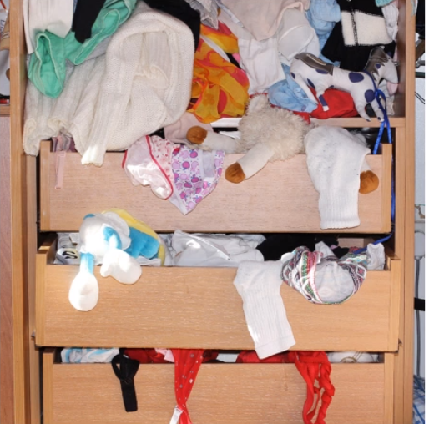
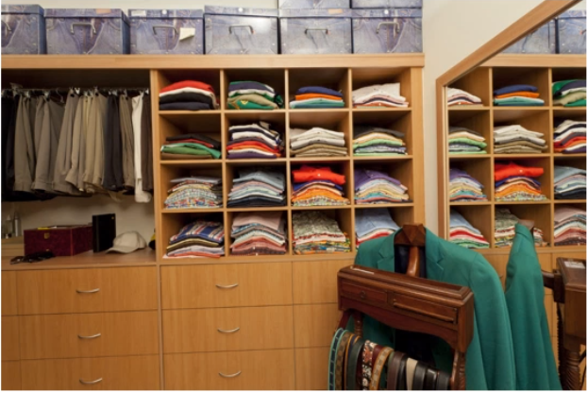
Separation of Concerns
Easy to put clothes away
Really hard to get dressed
A bit more work to put things away
Makes getting dressed easy

Slide 23
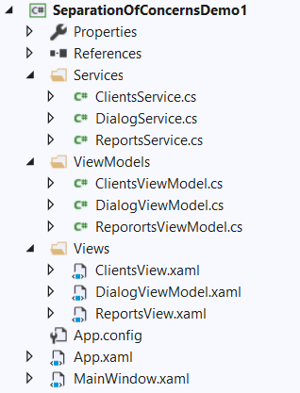
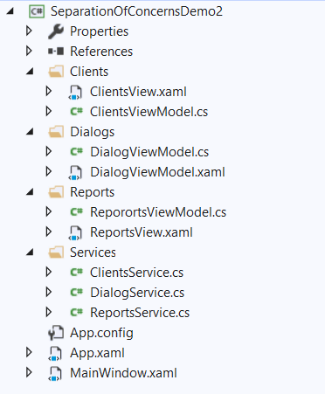
Separation of Concerns (2)

Slide 24
MVVM Architecture
MVVM consists of three layers
View is the Presentation Layer
Contains only GUI elements, but no functionality
Model is an object model that represents the real state content
A data access layer that represents that content
Holds just pure C# objects and data
Should not be coupled with a concrete technology and its DLLs (WPF or Silverlight)

Slide 25
MVVM Architecture (2)
ViewModel is a "Model of the View"
Abstraction of the View
Serves in data binding between Views and Models
Acts as a binder/converter of data
Passes commands from the View into the Model
Exposes public properties, commands, and abstractions
Should be as less coupled with technology as possible

Slide 26
MVVM Responsibilities
View
ViewModel
Client Services / Repositories
Model Object
Model Object
Model Object

Slide 27
MVVM Layers Connections
The idea of MVVM is to make the layers loosely coupled
The View knows only about the ViewModel
The View has no idea of the Model
The ViewModel only knows about the Model
The ViewModel has no idea of the View
The Model knows nothing about the other layers
View
ViewModel
Model

Slide 28
MVVM Goals
Maintainability
Testability
Extensibility

Slide 29
MVVM Across Platforms
WPF
Silverlight
Windows 10
Window8/WinRT
Xamarin/ Mobile Apps
HTML5 (Knockout/ Angular)

Slide 30

Speech Recognition

Slide 31
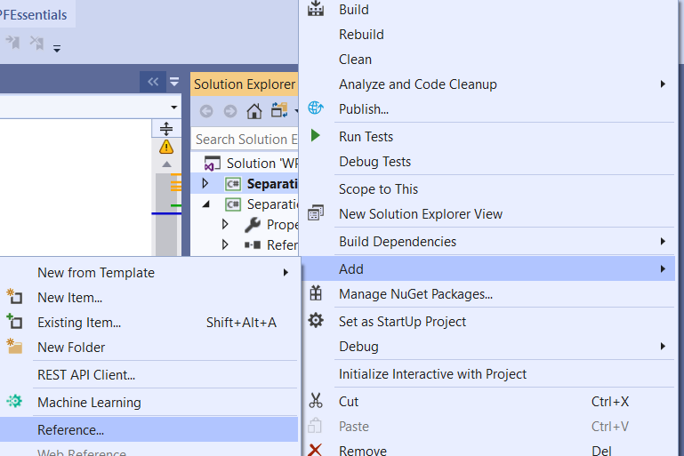
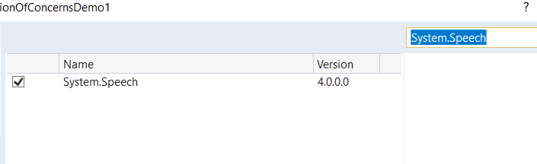

Speech Recognition
Add referenced – System.Speech
Install if it's needed

Slide 32
Voice Recognition Example
<ToggleButton Name="ButtonToggleListening" Click="ButtonToggleListening_Click" Content="Listen"/>
<Label Name="Label" HorizontalAlignment="Center" VerticalAlignment="Center" FontSize="48"/>
SpeechRecognitionEngine speechRecognizer = new SpeechRecognitionEngine();
public MainWindow() {
InitializeComponent();
speechRecognizer.SpeechRecognized += SpeechRecognizer_SpeechRecognized; GrammarBuilder grammarBuilder = new GrammarBuilder(); Choices valueChoices = new Choices(); valueChoices.Add("softuni", "csharp"); grammarBuilder.Append(valueChoices); speechRecognizer.LoadGrammar(new Grammar(grammarBuilder)); speechRecognizer.SetInputToDefaultAudioDevice(); }

Slide 33
Voice Recognition Example (2)
private void ButtonToggleListening_Click(object sender, RoutedEventArgs e){ if (ButtonToggleListening.IsChecked == true) speechRecognizer.RecognizeAsync(RecognizeMode.Multiple); else speechRecognizer.RecognizeAsyncStop();}
private void SpeechRecognizer_SpeechRecognized(object sender, SpeechRecognizedEventArgs e){
Label.Content = e.Result.Text; if (e.Result.Words.Count == 1) { string command = e.Result.Words[0].Text.ToLower(); if (command == "softuni") Label.Content = "SoftUni"; else if (command == "csharp") Label.Content = "In Love with C#"; }}}

Slide 34

Summary
What is XAML?
What is XML?
XAML Features
MVVM
Architecture
Goals
Separation of Concerns
…
…
…

Slide 35












SoftUni Diamond Partners
Notes:
35

Slide 36




SoftUni Organizational Partners
Notes:
36

Slide 37




Trainings @ Software University (SoftUni)
Software University – High-Quality Education and Employment Opportunities
softuni.bg
Software University Foundation
http://softuni.foundation/
Software University @ Facebook
facebook.com/SoftwareUniversity
Software University Forums
forum.softuni.bg

Slide 38

License
This course (slides, examples, demos, exercises, homework, documents, videos and other assets) is copyrighted content
Unauthorized copy, reproduction or use is illegal
© SoftUni – https://softuni.org
© Software University – https://softuni.bg
Notes:
38

